Slide 1
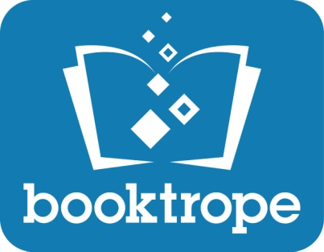
Katherine Fye Sears
Booktrope Co-Founder/CMO
Co-Author of How to Market a Book
Lisa Fernow
Marketing Professional
Author, Dead on Her Feet
www.booktrope.com

Slide 2
Answer to the #1 Question I hear…
Right now
Notes:
Katherine

Slide 3
Agenda
State of the Union
Marketing concept
Q&A with Lisa/Katherine
Must haves
Q&A with Lisa/Katherine
Strongly recommended
Q&A with Lisa/Katherine
Nice to have – Optional activities
Quiz game – PRIZES!!!!
Final Q&A
Notes:
Katherine

Slide 4
Things we will not be covering…
How to write a book
How to write a press release or get into newspapers
How to get reviews
How to get into book stores
Booktrope
Any of the above are fair game in the final Q&A, time permitting….
Notes:
Katherine

Slide 5
Publishing
The state of the union

Slide 6
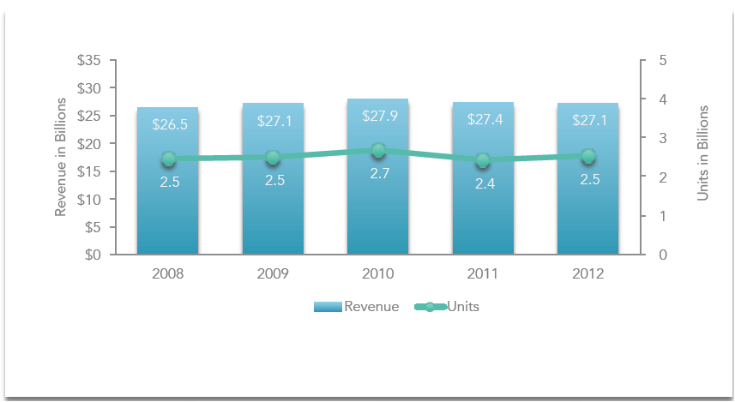
Publishing Market
**Data via BISG study August 2013
Notes:
Katherine
Per Publishers Weekly 2013 revenue was $27.01B. (The rest of the article follows if you want to take some facts). No units reported.
Industry sales were just about flat in 2013, falling by less than 1%, to $27.01 billion, from $27.12 billion in 2012, according to the newest figures from BookStats, the industry statistics program from the AAP and BISG.
RELATED STORIES:
More in News -> Financial Reporting
Want to reprint? Get permissions.
FREE E-NEWSLETTERS
PW Daily Tip Sheet
More Newsletters
Sales in the trade segment, the industry’s largest, fell 2.3%, to $14.63 billion, but revenue rose in the three other major categories. Sales of professional and scholarly books increased 1.3%, to $3.62 billion, while sales in the higher education category rose 1.1%, to $4.34 billion. Sales in the pre-k-12 segment increased 3.4%, to $4.41 billion.
Within the trade group, which BookStats includes religion in, only adult nonfiction posted a sales gain in the year, with revenue up 5.4%, to $4.65 billion. Sales of adult fiction fell 7.1%, to $5.04 billion, in part because of the fall-off in sales of the Fifty Shades trilogy, which had such huge success in 2012. Juvenile fiction sales dropped 4.9%, to $2.19 billion; the fall-off in sales of the Hunger Games trilogy, which was huge in 2012, had an impact here. Juvenile nonfiction sales fell 5.8%, to $644.8 billion. And sales in the religion segment fell 1.1%, to $1.37 billion.
In terms of formats within trade, e-book sales fell to $3.03 billion from $3.06 billion in 2012, due to a large decline in sales of e-books in the juvenile fiction segment, where sales declined 25.5%, to $347.7 million. In adult fiction, e-book sales rose in the year to $1.92 billion, a 2% increase over 2012. E-books accounted for 38% of adult fiction sales in 2013, compared to 34.7% in 2012. In adult nonfiction, e-book sales rose 6.8%, to $593.1 million, accounting for 12.8% of nonfiction sales, up from 12.6% in 2012. In the religion category, e-book sales rose 14.4%, to $146.2 million. While e-book sales for trade fell in 2013, the number of units rose 10%, to 512.7 million.
Within trade, hardcover remained the largest format in 2013, with revenue of over $5.14 billion, followed by trade paperback, with sales of $4.76 billion. Sales of mass market paperback, while falling 6.7%, still generated revenue of $781 million in the year.
Totals for BookStats are based on reports from 1,616 publishers which are then extrapolated to account for non-reporting companies.

Slide 7
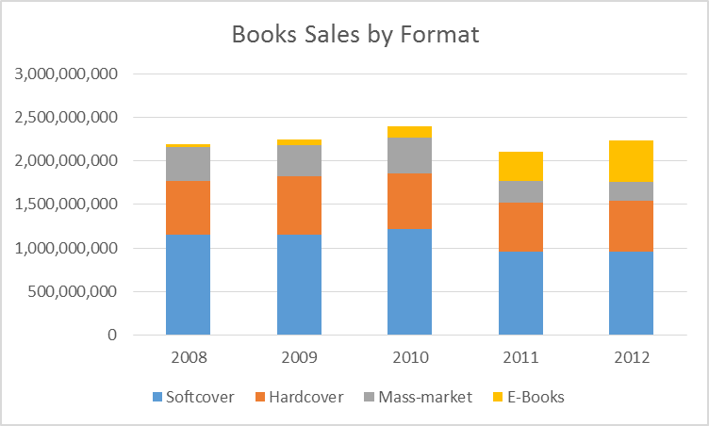
Publishing Market
**Data via BISG study August 2013
Notes:
Katherine
The final number for eCommerce in 2012 was 44%.
I checked and Bowker should have 2013 out in August.

Slide 8
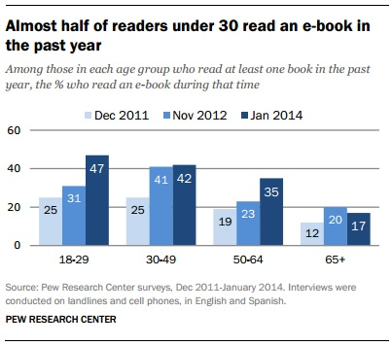
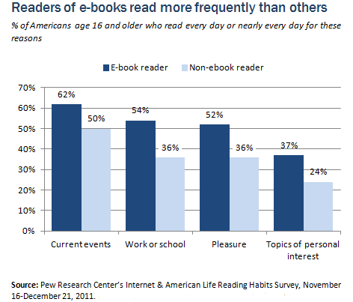
Publishing Market
Notes:
Katherine
In a February survey, 21% of adults said they had read a e-book in the last year, compared to 17% who reported doing so in December. This tracked with a major spike in ownership of e-reader devices that occurred during the holiday gift-giving season in December. During that period, ownership of an e-book reader or a tablet each increased to 19% of adults, compared to 10% for each device in mid-December.

Slide 9
So the opportunity is there…
Now what?

Slide 10
Build your platform!
The author platform is simply the supporting “structure” that all of your promotional efforts are based upon.

Slide 11
Book Marketing = Internet Marketing = Word of Mouth Marketing
What is Word of Mouth Marketing?
Put simply, it is "any business action that earns a customer recommendation.“ But, in the big world of creative campaigns and engagement techniques, WOMM means much more.
WOMM is about harnessing the power of
people to build brand awareness.
--per WOMMA via http://www.wommapedia.org/
Notes:
Katherine

Slide 12
Word of Mouth Marketing
Notes:
Katherine

Slide 13
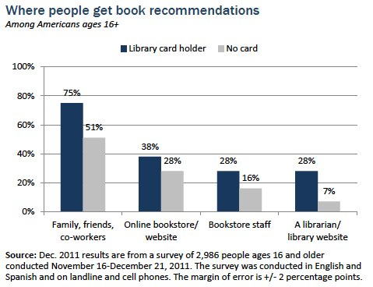
Word of Mouth Marketing
Notes:
Katherine
I tried to find more recent data and couldn’t find anything.

Slide 14
Question and Answers
5 minutes of questions!
Please tell us who you are directing your question to.

Slide 15
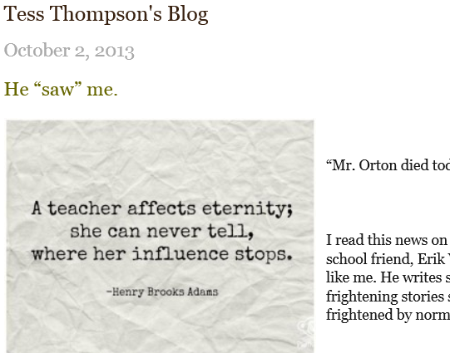
Marketing Strategy: Author Platform
: Author is the focus!
Book 2
online
content
author
Book 3
Lisa Fernow
personal
social
Notes:
Katherine

Slide 16
Dead on Her Feet Strategic Blueprint Format
Positioning: DOHF is targeted to the tango community and to readers 30+ who enjoy “classic” mysteries that fall between “cozy” and hardboiled police procedurals, that immerse them in an exciting, glamorous world. Examples: Ngaio Marsh (theatre), Elizabeth Peters (archaeology), Peter Lewis (wine), Rosemary Harris (gardening). DOHF should transport people to the tango world, with all its elements of passion, seduction and betrayal. DOHF may also eventually appeal to people who watch dance shows and to Castle/Bones fans, who enjoy the relationship angle.
Strategy: Build relationships with potential tango and mystery influencers and readers using their media and “reciprocal currency” of choice. Lead with the tango community, and Lisa’s personal network. Heavy-up efforts in select markets where tango and mystery readership intersect to build critical mass and momentum.
Overarching Objective: Sell 10,000 copies in 3 years.
Product and Packaging
Objectives:
Favorable reviews outnumber unfavorable reviews by 2:1
Sell more than (name withheld to protect the guilty)
Strategies:
Product: eBook for Kindle, iPad; Trade paperback
Packaging: cover should work as thumbnail and IRL
Blurbs from tango and mystery authorities
Place
Objectives:
Online distribution on all key US and English speaking websites
Enable key mystery bookstores to order
Strategies:
Target Amazon – find exact ‘code’ to be classified under using similar books as guide
Free samples to mystery bookstores in priority markets, and to influential tastemakers
Treat every retailer fairly and equally
“Price”
Objectives:
Profitably build audience for future books in the series
Strategies:
Penetration price to sell maximum number of units, working within BT guidelines
Free copies to influencers
Promotion
Objectives:
Comes up #1 in “tango mystery” search
# People signed up for email or blog posts
# relationships formed at events
Strategies:
Build relationships with tango community and mystery tastemakers and promoters who can advise, review, promote, and provide content – and support them in return with whatever they need - virtuous circle that will ensure I continue to have plenty of fodder and support for future stories
Use website to curate tango, mystery related content, and other interesting content
SEO for website / posts
Social media prioritized based on where to best engage tango and mystery reading audiences
Tango or mystery events in key cities, to extent can execute
Start Book #2!!!!
Tone: authentic (tango is real), classic (follows in the tradition of the classic who-dun-its), naughty and fun
Notes:
Lisa
A cleaner version of what I’m working from … will be too small to read but perhaps we flash this up just to say I thought hard about each piece of the marketing mix.

Slide 17
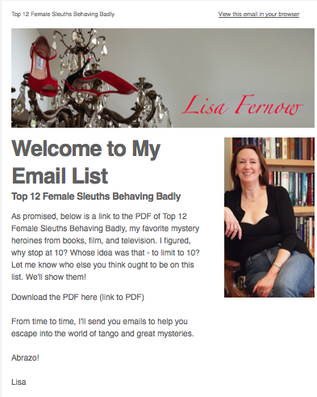
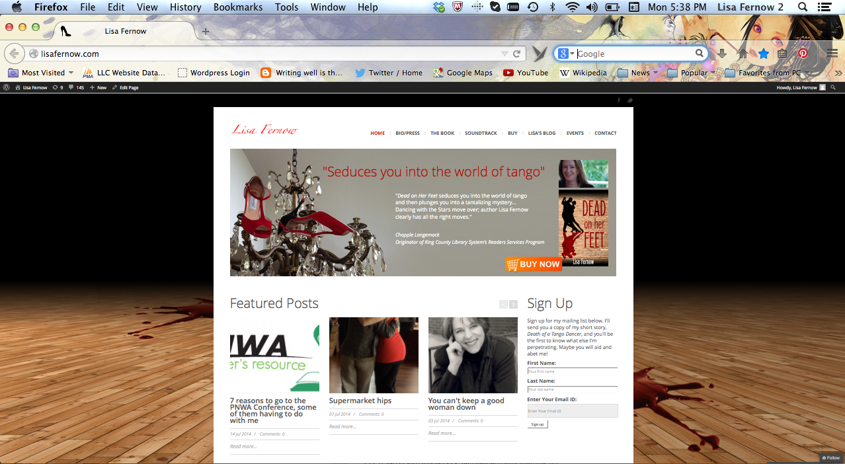
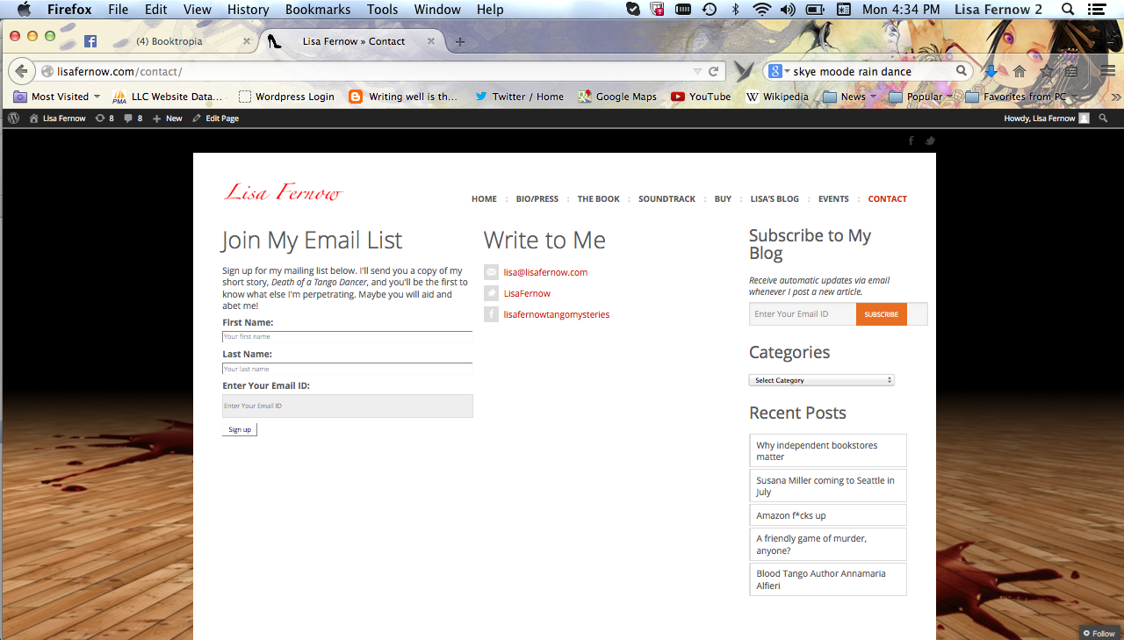
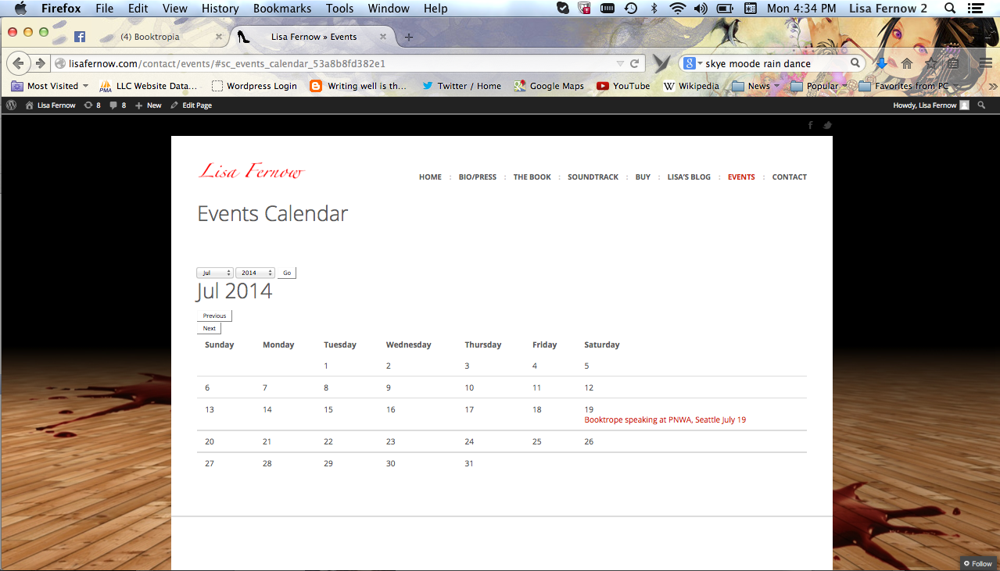
Website – Online to Personal
Notes:
Lisa

Slide 18
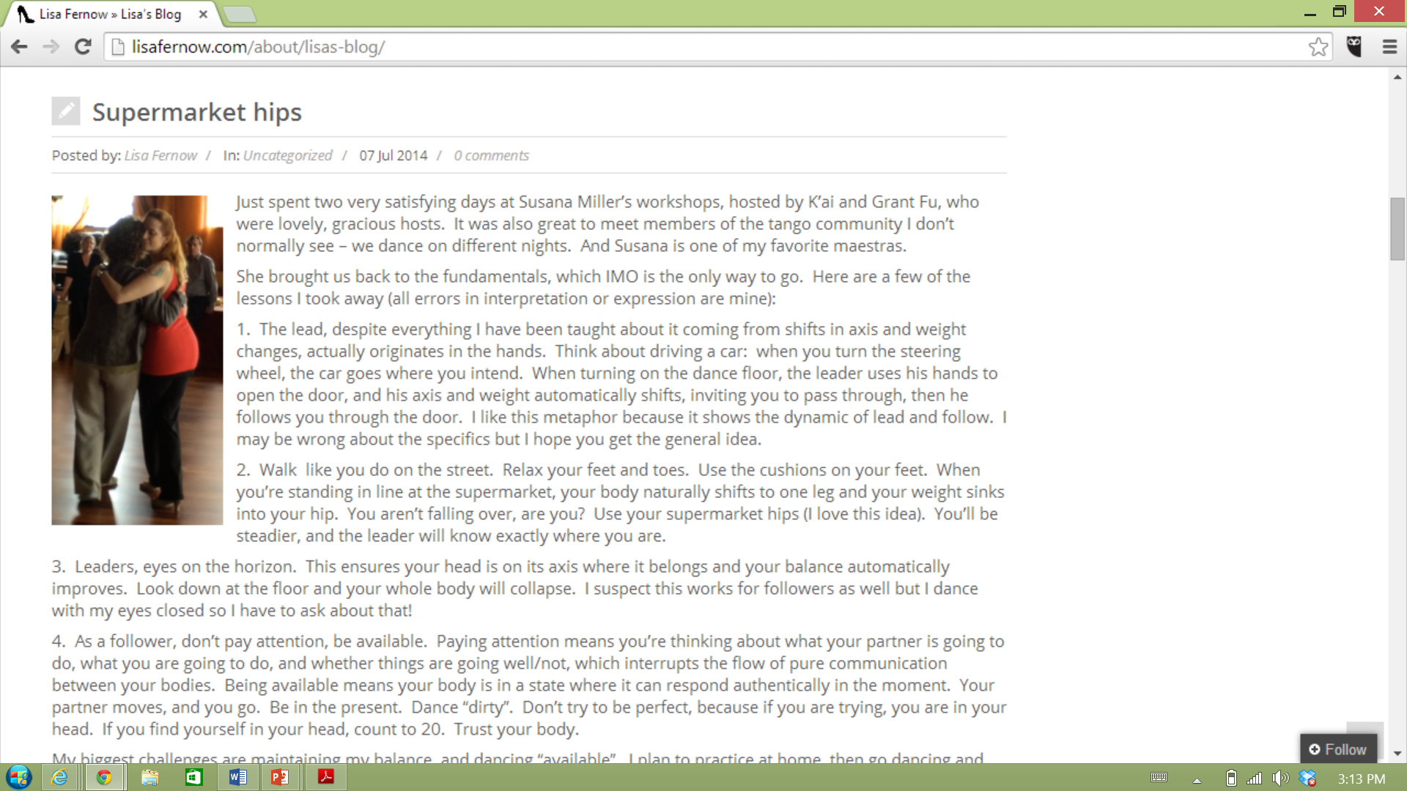
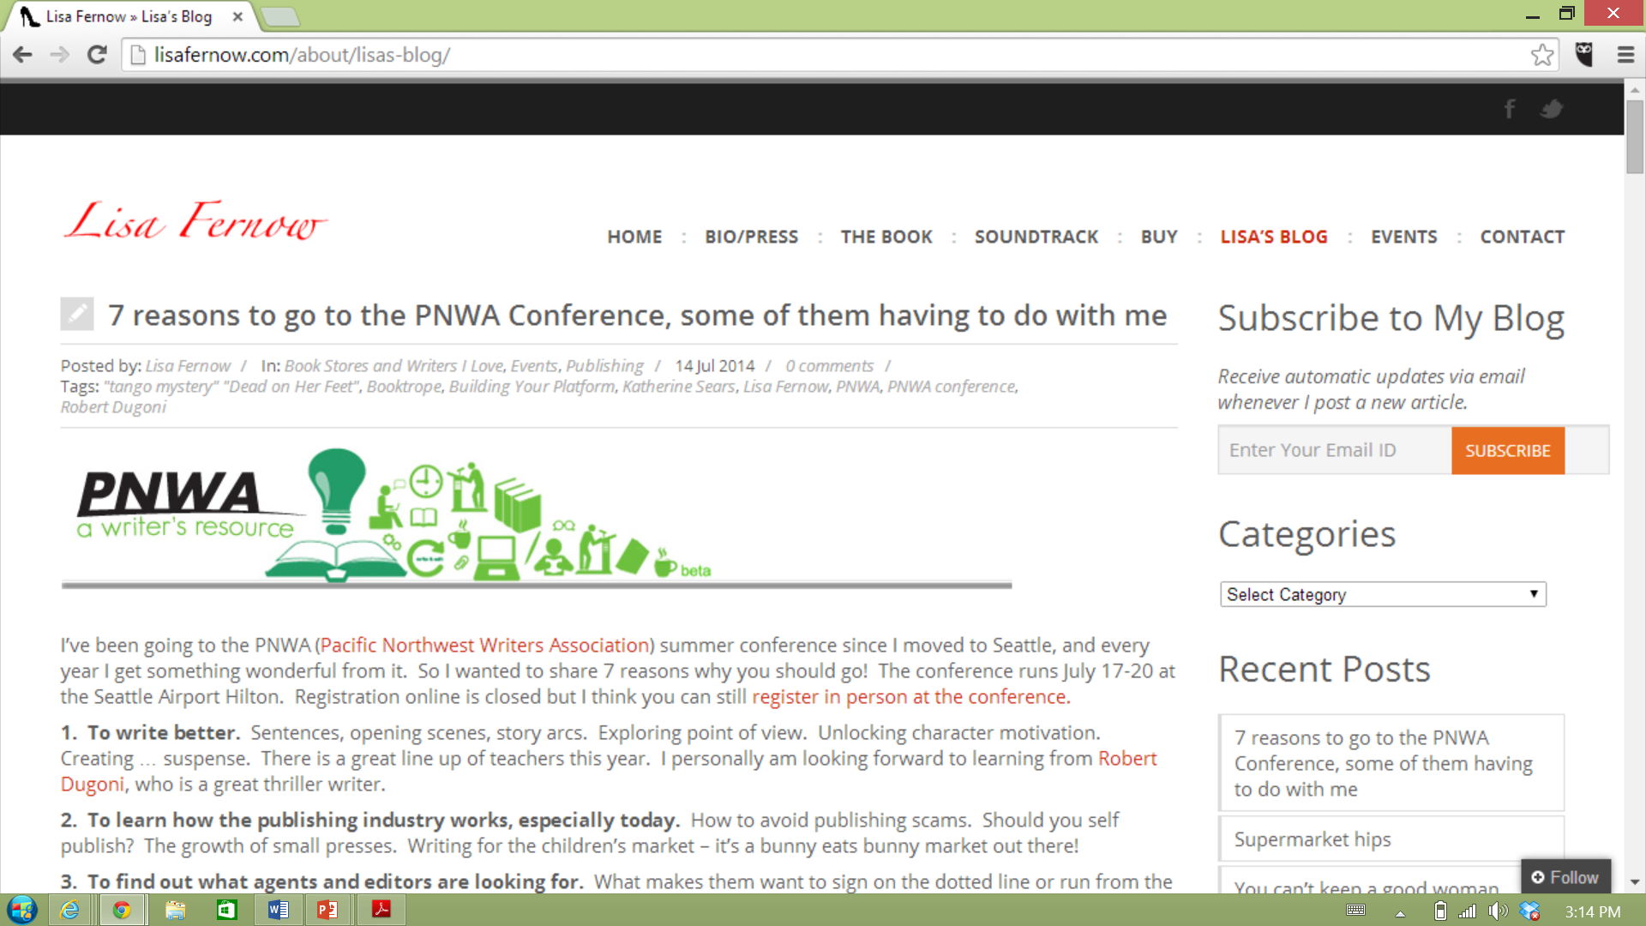
Blog (yours) - Content
Notes:
Lisa

Slide 19
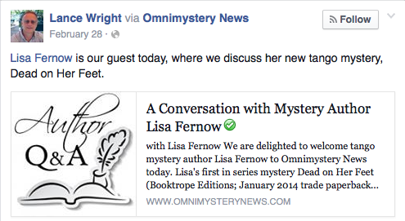
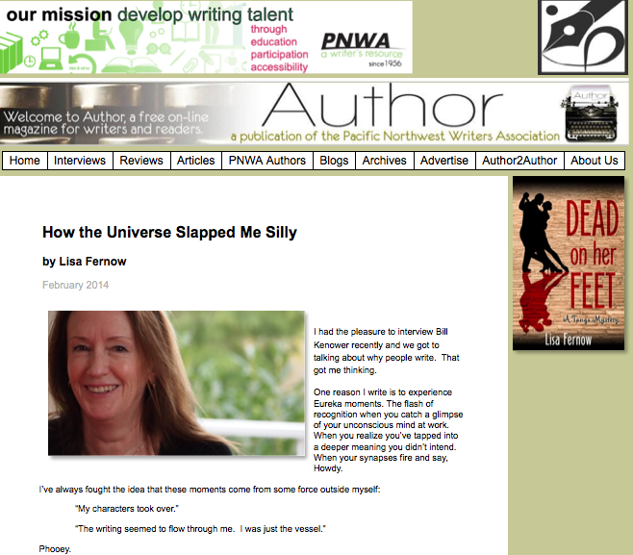
Blog/Website (others) - Content
Notes:
Katherine

Slide 20
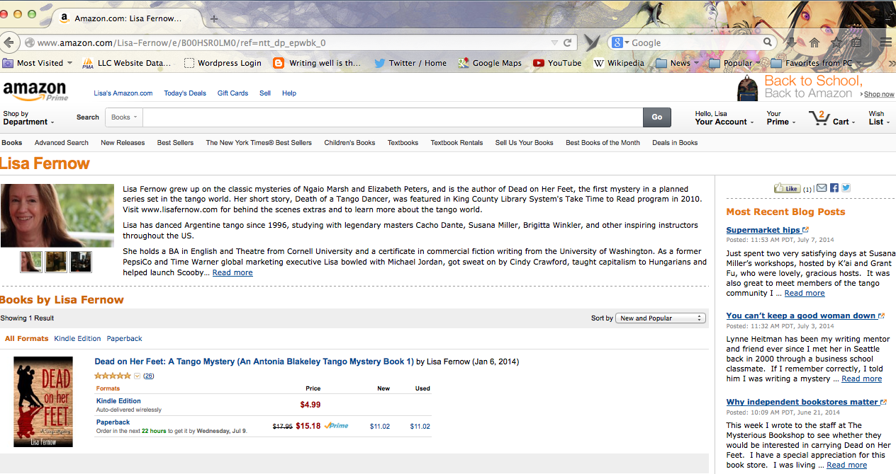
Author Central (Amazon)
Notes:
Lisa

Slide 21
Social Media Presence
Notes:
Katherine

Slide 22
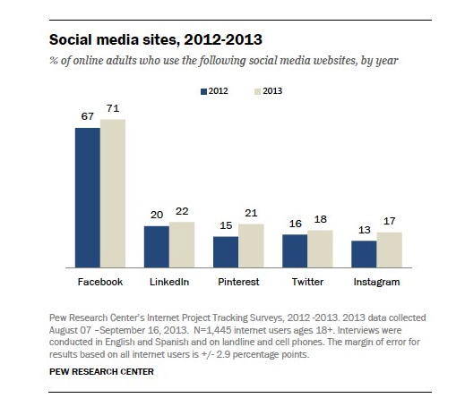
How do you decide?
Social media skews, 2013
Facebook | Broad appeal
Linked In | College graduates and higher income households
Pinterest | female
Twitter | younger adults, urban dwellers, and non-whites
Instagram
Pew Research Center’s Social Media Update - 2013
Notes:
Katherine
Women are responsible for about 67% of mass market paperback purchases. They are also more likely to be book buyers (in general) than men (about 62% of women are book buyers, as opposed to only about 44% of men). Also, a woman is more likely to purchase multiple books per year than a man.
Most recent stats from http://www.pewinternet.org/fact-sheets/social-networking-fact-sheet/
Some 42% of online adults now use multiple social networking sites. http://www.pewinternet.org/2013/12/30/social-media-update-2013/

Slide 23
Facebook
Notes:
Lisa

Slide 24
Twitter
Notes:
Lisa

Slide 25
LinkedIn
Notes:
Lisa

Slide 26
Question and Answers
5 minutes of questions!
Please tell us who you are directing your question to.

Slide 27
Strongly Recommended
Pinterest
YouTube
Google+
Goodreads
Key Genre Specific sites
Book Bloggers
Notes:
Katherine

Slide 28
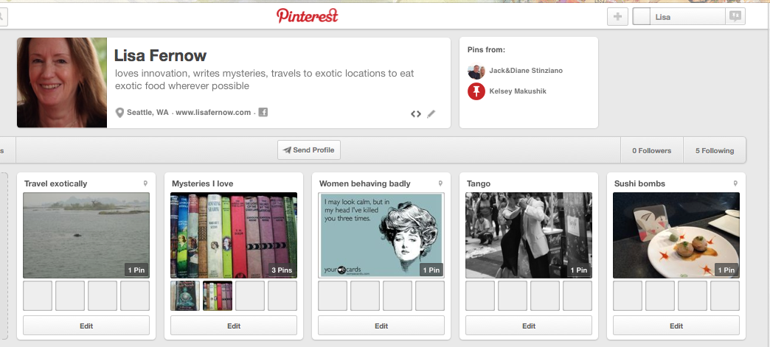
Pinterest
Notes:
Lisa

Slide 29
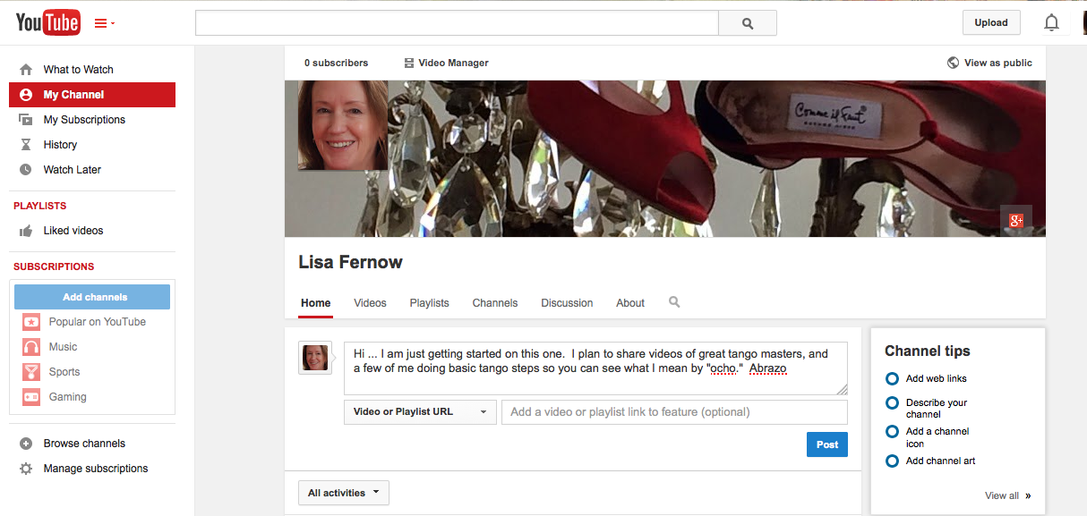
YouTube
Notes:
Katherine

Slide 30
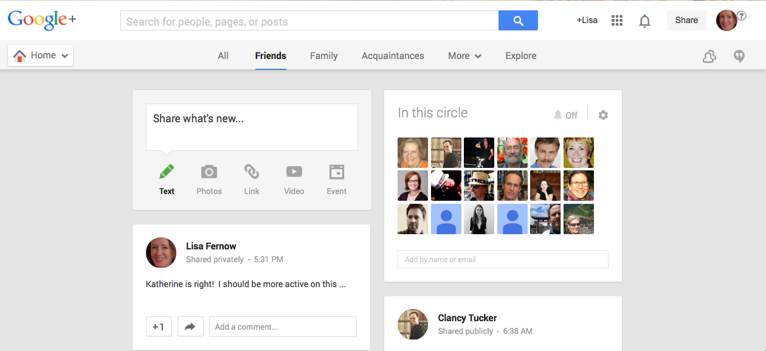
Google+
Notes:
Katherine

Slide 31
Goodreads
Notes:
Katherine

Slide 32
Optional - Genre Specific
Notes:
Lisa

Slide 33
Question and Answers
5 minutes of questions!
Please tell us who you are directing your question to.

Slide 34
Optional
Reddit
Quora
Genre Specific or Target specific: ex.
Mamapedia
i09
Huffington Post
More Book Bloggers
Other Book Sites
LibraryThing
Wattpad
Notes:
Katherine

Slide 35
Question #1
Name one of the top three things you MUST have in your author platform?

Slide 36
Question #2
Name one of the ways to offer content?

Slide 37
Question #3
How do you decide where to start with
social media?

Slide 38
Q&A
Any final questions?

Slide 39
Katherine Fye Sears
Booktrope Co-Founder/CMO
Co-Author of How to Market a Book
Lisa Fernow
Marketing Professional
Author, Dead on Her Feet
www.booktrope.com

